Slide 1




Rbims: R tools for reconstructing bin metabolisms
useR - 2021
Mirna Vázquez Rosas Landa, Ph.D.
The University of Texas at Austin
Vázquez-Rosas-Landa, M., De Anda, V., Shah, S., Baker, B.

Slide 2
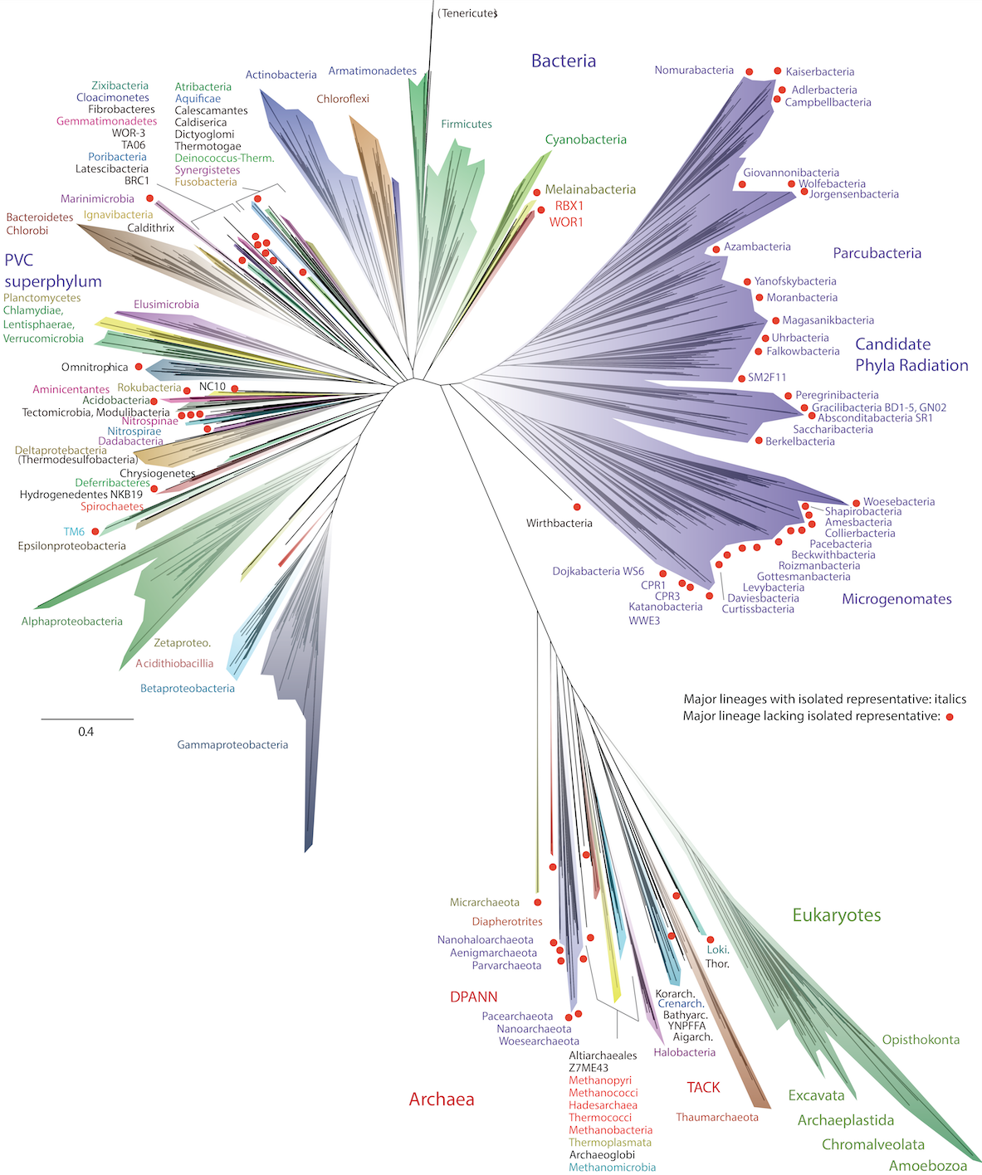
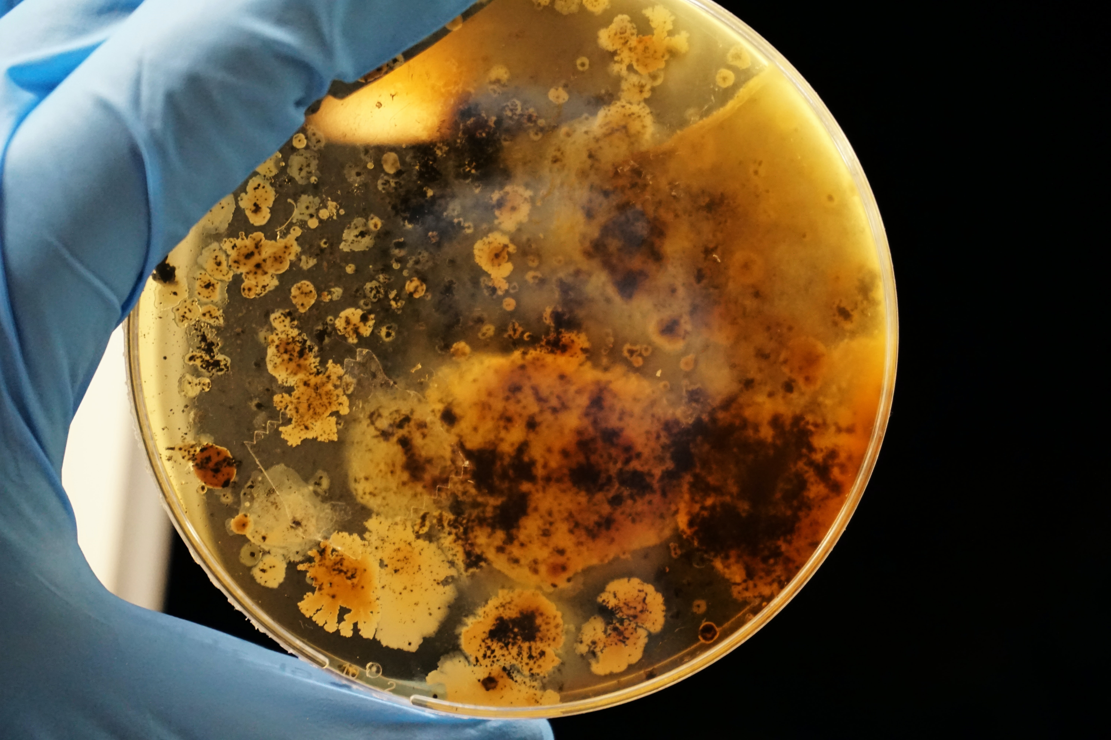
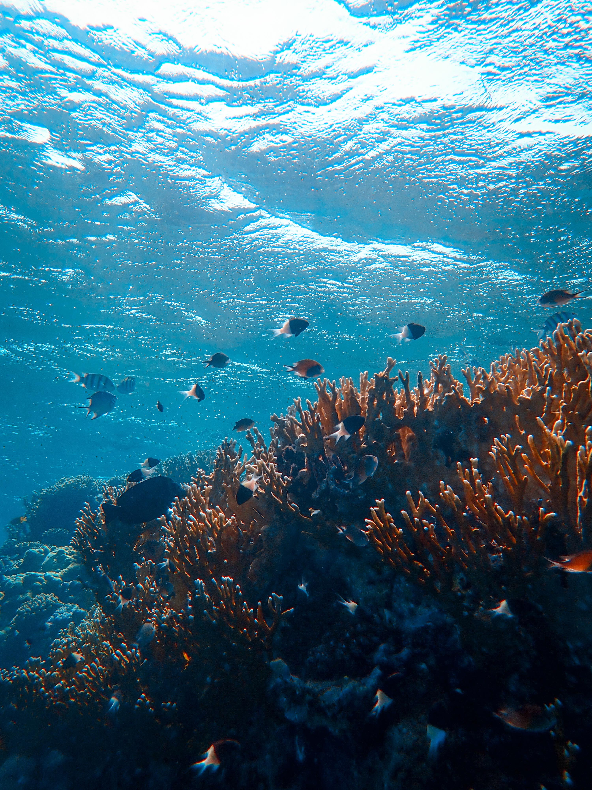
Cultures
Uncultured
Metagenomics
Uncultured lineage
Metagenome-assembled genome (MAG) / (Bins)
(Hug et al., 2016)

Slide 3
We know nothing!
Studying their genomes to figure out their metabolic potential!
(Hug et al., 2016)

Slide 4

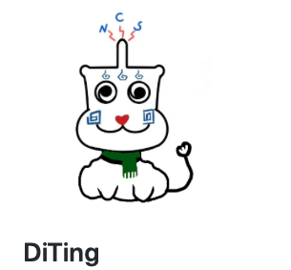
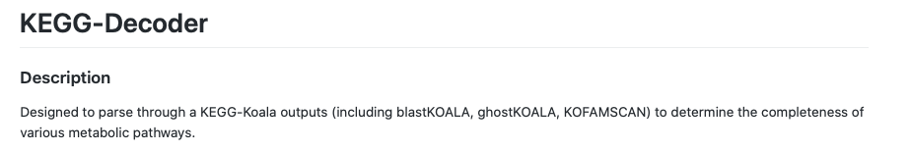

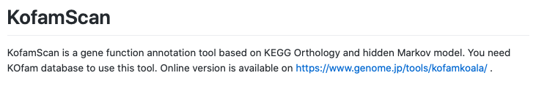

Slide 5
Rely databases that the user can’t modify.

Slide 6
Rely databases that the user can’t modify.
Do not have visualization.

Slide 7
Rely databases that the user can’t modify.
Do not have visualization.
Not allow the incorporation of metadata for hypothesis testing.

Slide 8

An R package to explore genome metabolism!
Reproducibility.
Allow pathway definitions.
Visualization alternatives.
Uncultured lineage
Metagenome-assembled genome (MAG)
(Hug et al., 2016)

Slide 9
An R package to explore genome metabolism!
Reproducibility.
Allow pathway definitions.
Visualization alternatives.
Uncultured lineage
Metagenome-assembled genome (MAG)
(Hug et al., 2016)

Slide 10
An R package to explore genome metabolism!
Reproducibility.
Allow pathway definitions.
Visualization alternatives.
Uncultured lineage
Metagenome-assembled genome (MAG)
(Hug et al., 2016)

Slide 11
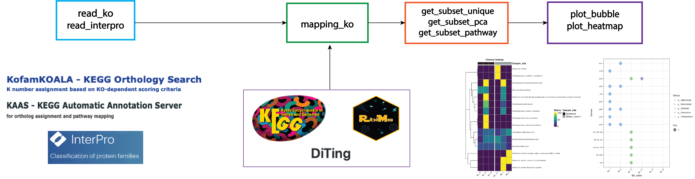
READ
MAP
Subset
Plot

Slide 12
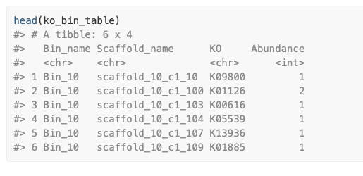
READ
MAP
Subset
Plot

Slide 13
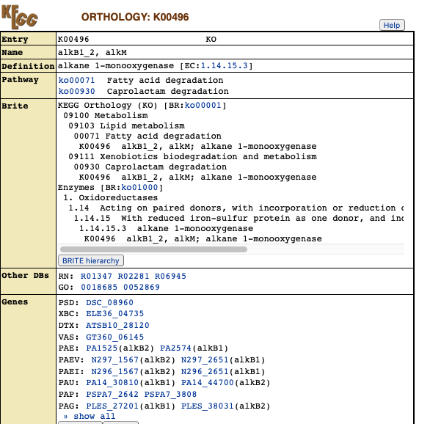
READ
MAP
Subset
Plot

Slide 14
Bin | KO1 | KO2 | KO3 | KO4 | KO5
Bin1 | 1 | 1 | 1 | 0 | 1
Bin2 | 1 | 0 | 1 | 0 | 1
Bin3 | 1 | 0 | 1 | 1 | 1
Bin4 | 0 | 1 | 0 | 0 | 1
Water column
?get_subset_unique
Sediment
READ
MAP
Subset
Plot

Slide 15
Bin | KO1 | KO2 | KO3 | KO4 | KO5
Bin1 | 1 | 1 | 1 | 0 | 1
Bin2 | 1 | 0 | 1 | 0 | 1
?get_subset_pathway
Sulfur metabolism
READ
MAP
Subset
Plot

Slide 16
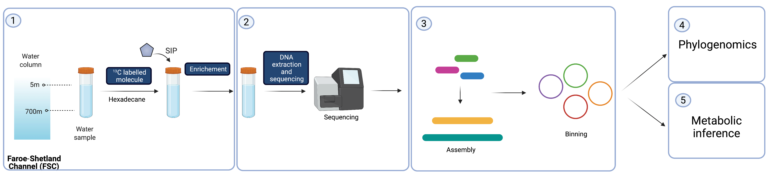

Bacteria that eat petroleum
(Vázquez-Rosas-Landa., et al., in progress)

Slide 17
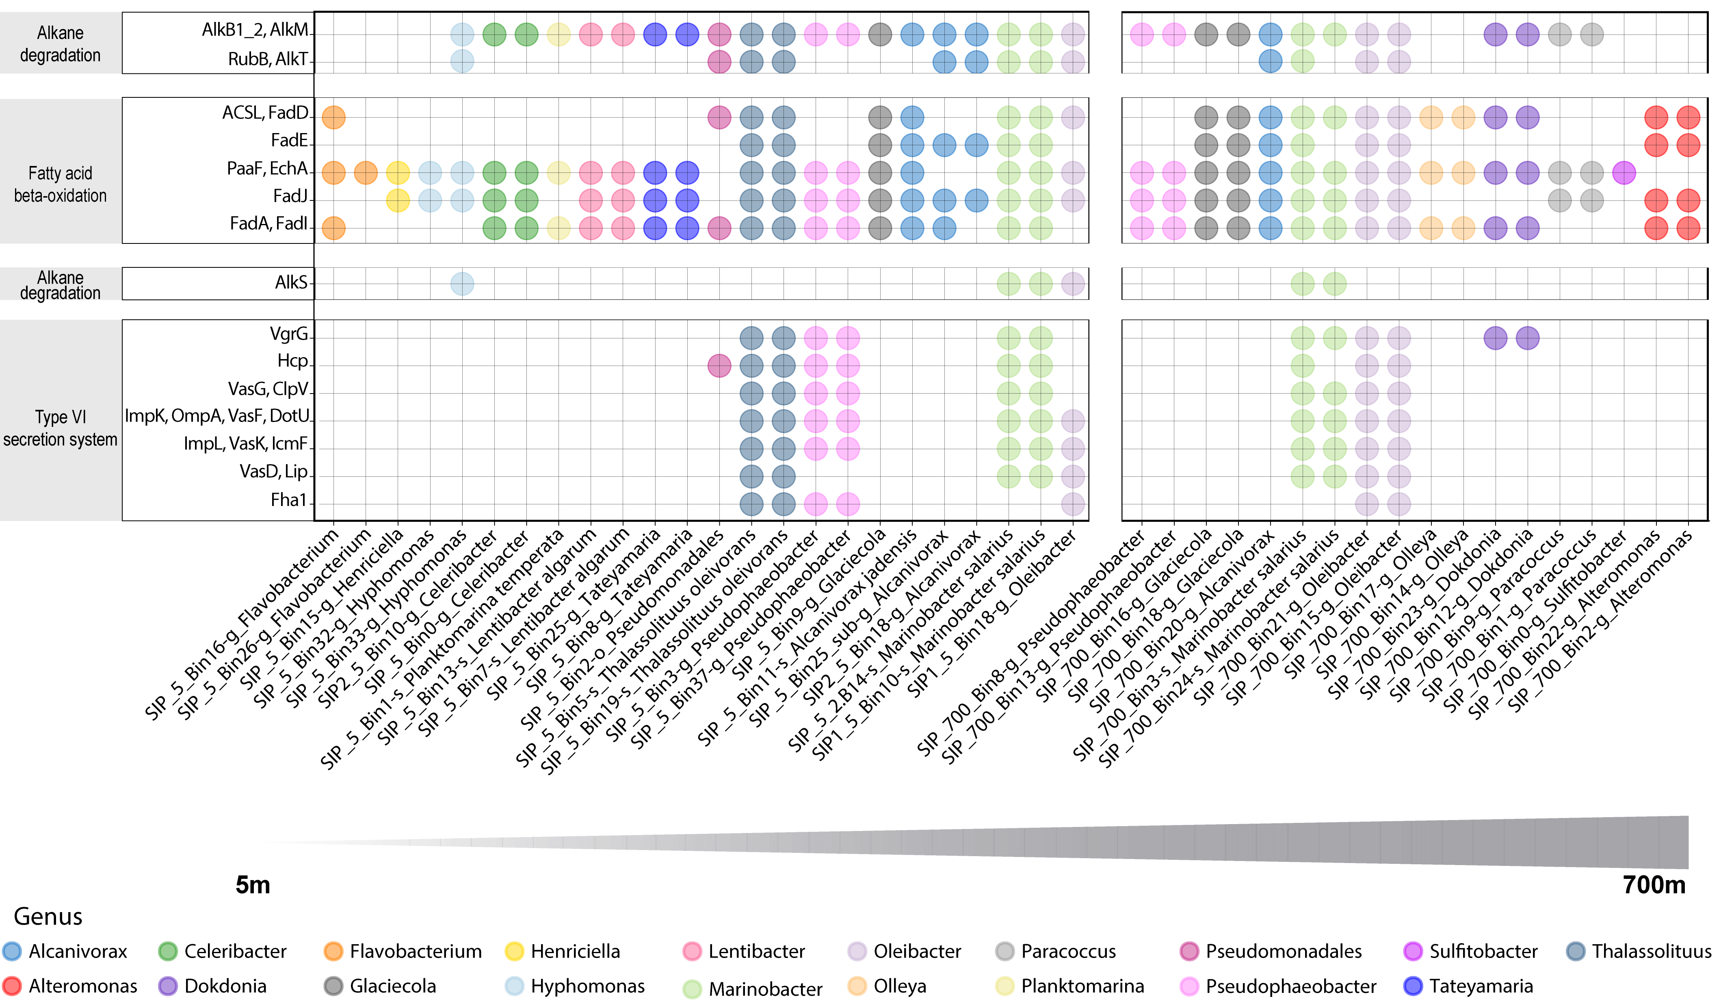
KEGG workflow
read_ko(“data/kofam/”) %>%
mapping_ko() %>%
get_subset_pathway(rbims_pathway, “Hexadecane”) %>%
plot_bubble()
READ
MAP
Subset
Plot
(Vázquez-Rosas-Landa., et al., in progress)

Slide 18
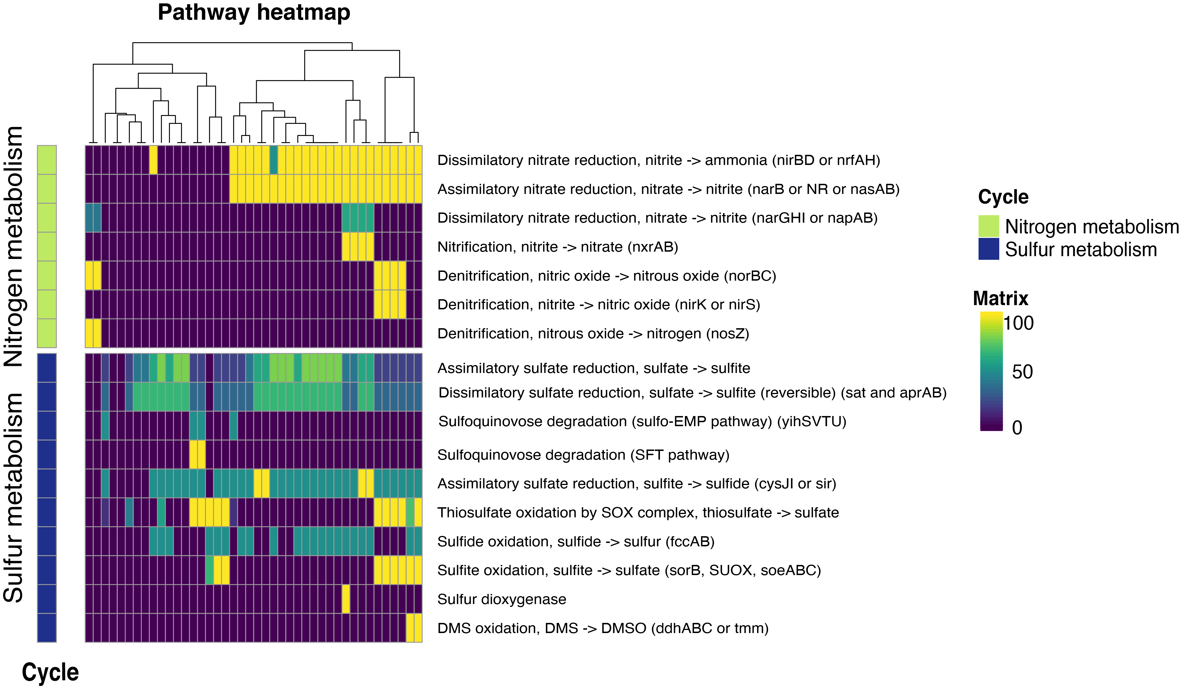
KEGG workflow
read_ko(“data/kofam/”) %>%
mapping_ko() %>%
get_subset_pathway(cycles, c("Nitrogen metabolism", "Sulfur metabolism")) %>%
plot_heatmap()
READ
MAP
Subset
Plot
(Vázquez-Rosas-Landa., et al., in progress)

Slide 19
KEGG workflow
Energy<-c(“K00496”, ” K00071”, “K00930”)
read_ko(“data/kofam/”) %>%
mapping_ko() %>%
get_subset_pathway(KO, Energy) %>%
plot_heatmap()
READ
MAP
Subset
Plot
You can define your pathways!
(Vázquez-Rosas-Landa., et al., in progress)

Slide 20
Complete the metabolic puzzle of unexplored genomes!
READ
MAP
Subset
Plot
And understand their role in the environment!
(Hug et al., 2016)

Slide 21

Prospective
read_dbcan
read_merops
get_completeness
Bin_tools
READ
MAP
Subset
Plot

Slide 22
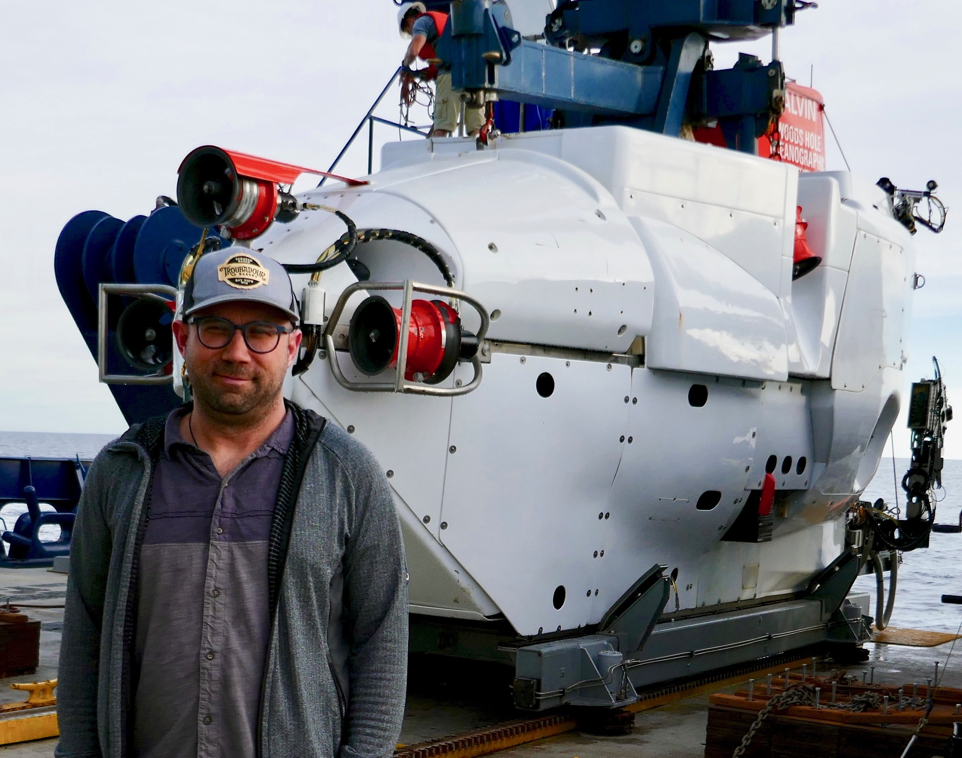
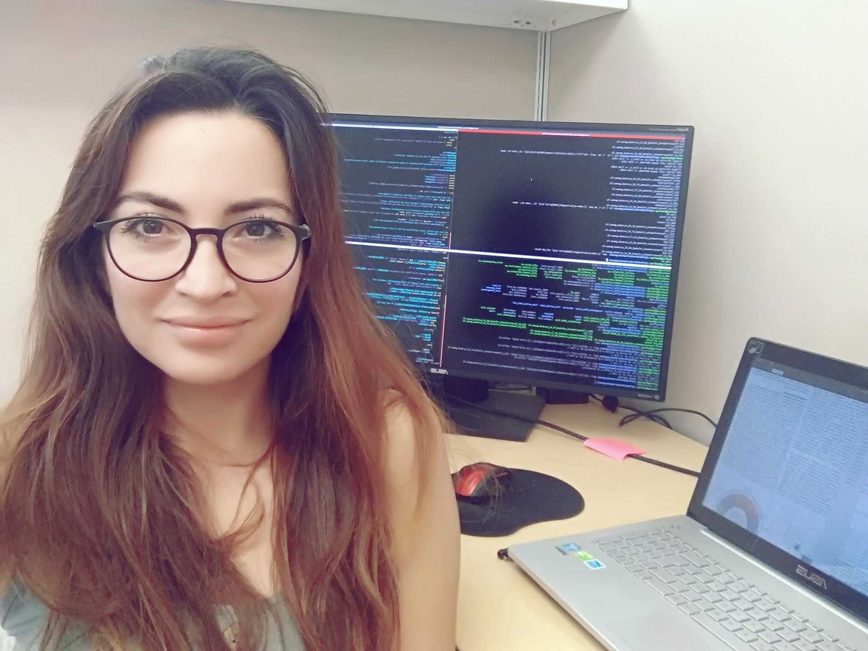
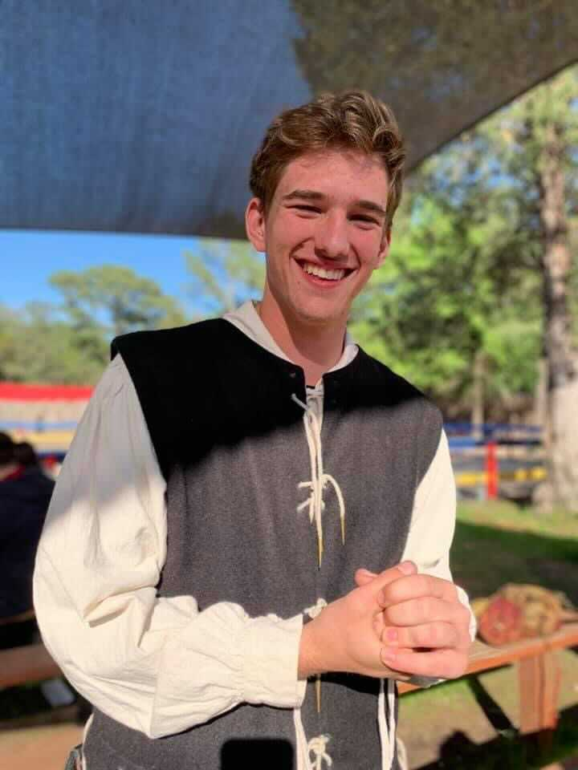
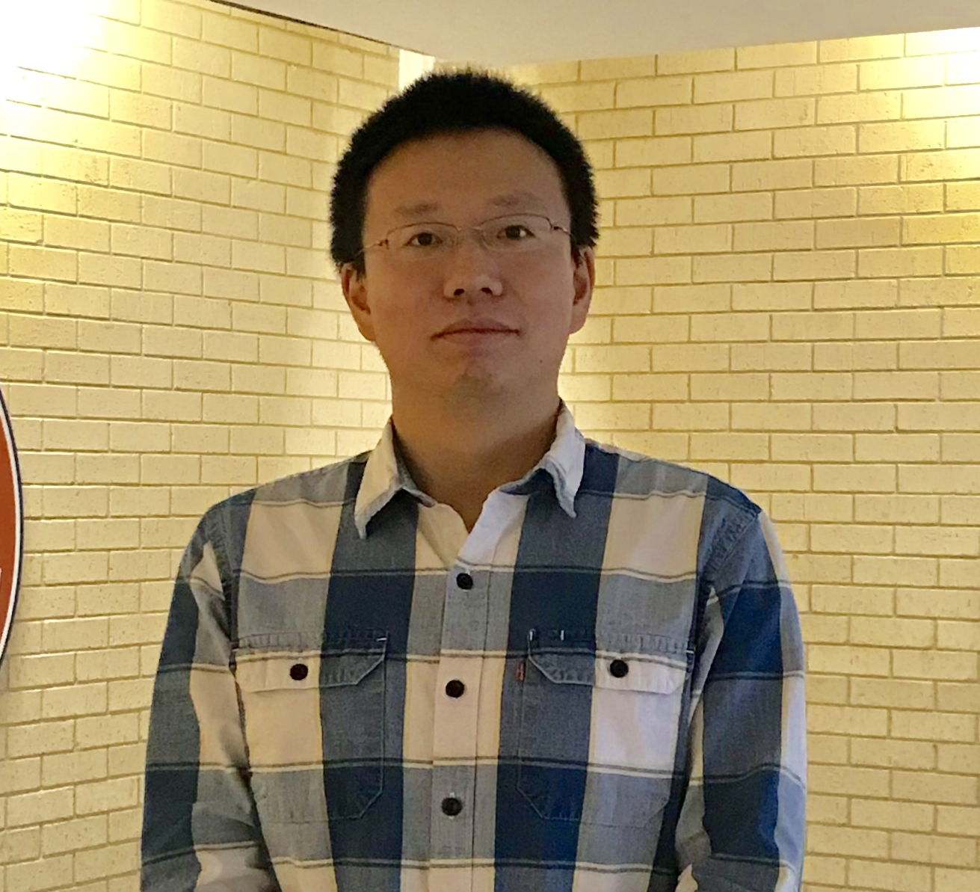
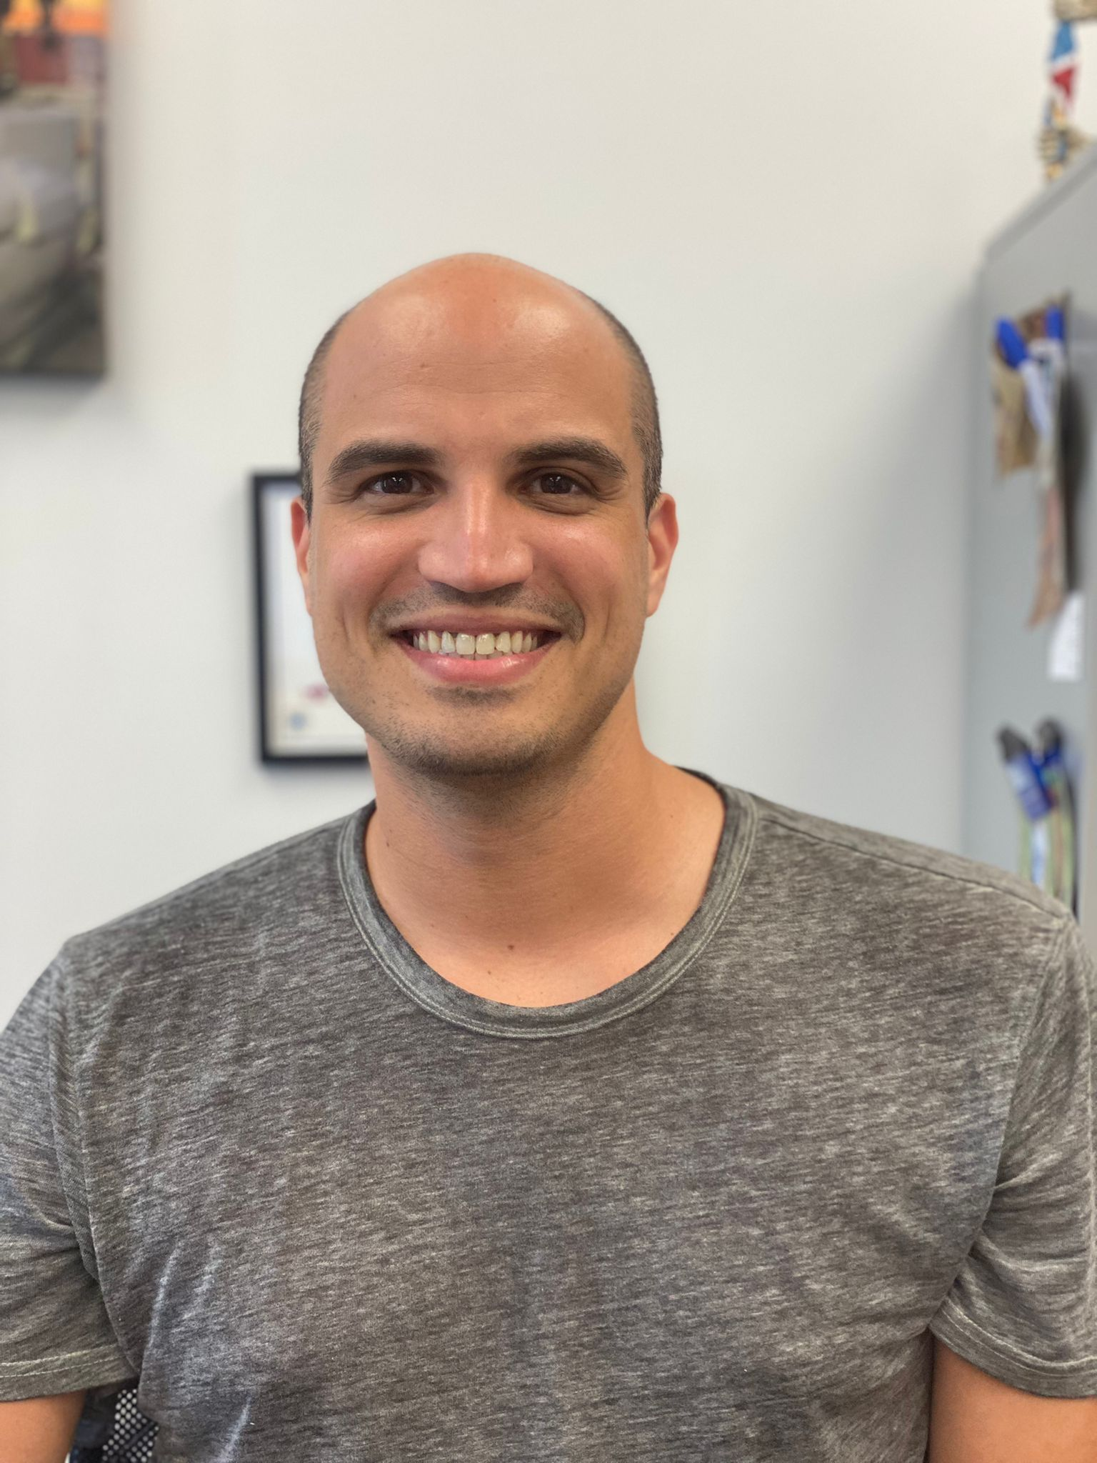
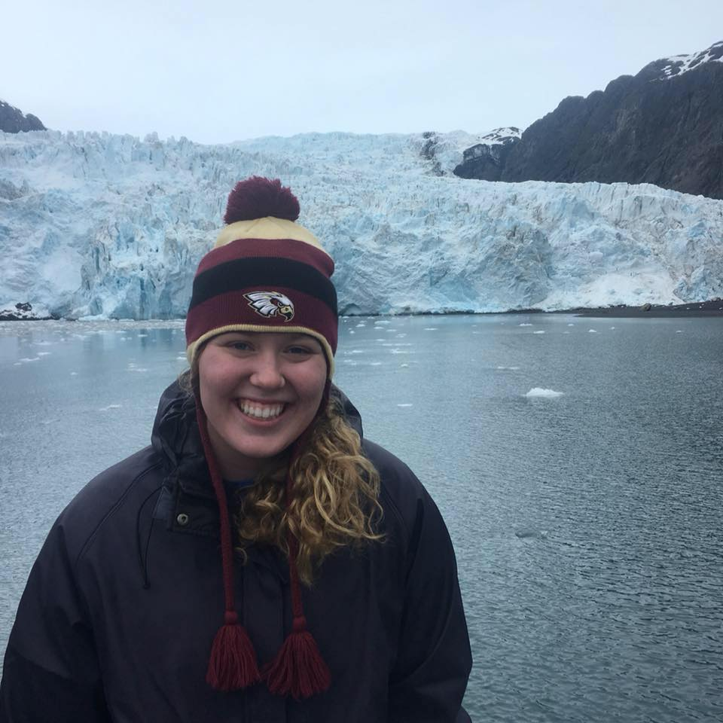
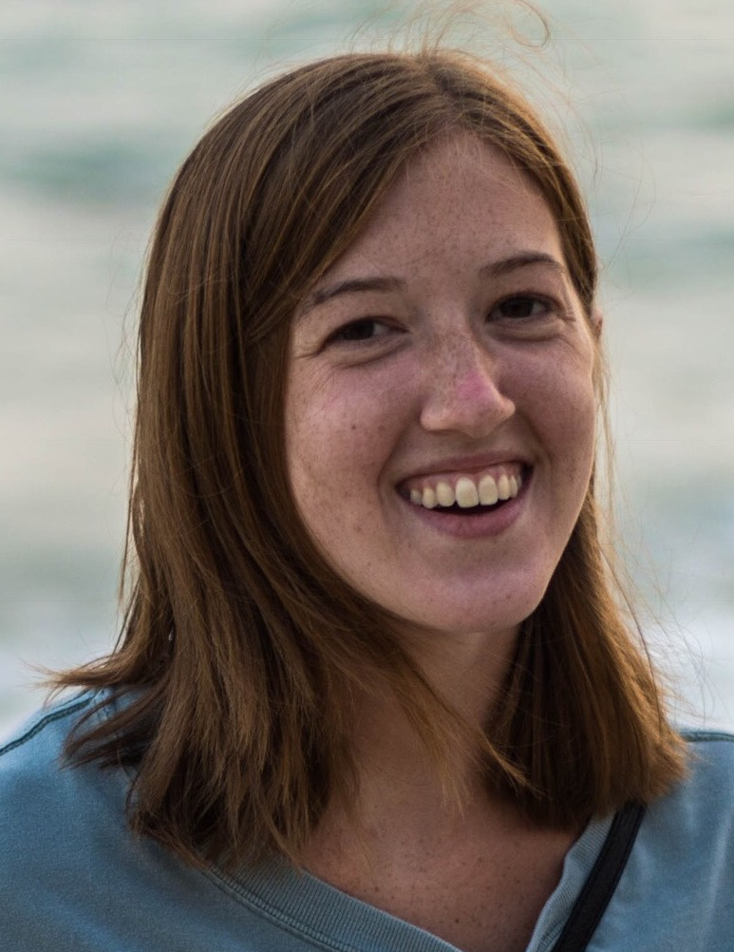
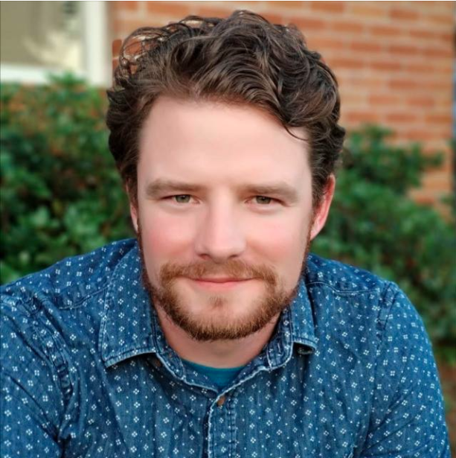
Acknowledgments
Group leader
BakerLab
Contributions
Brett Baker
Valerie De Anda and Pedro Leão - Curated the rbims database of metabolism.
Sahil Shah - Helped with function documentation.
New contributor – Bryan Vernon
Valerie de Anda
JD Carlton
Xianzhe Gong
Ian Rambo
Pedro Leão
Kathryn Appler
Maggie Langwig

